Slide 1
Data Science Bootcamp
Rutgers Cognitive Science Club x Rutgers Statistics Club
Teaching you the technical skills you need to stand out and make a difference

Slide 2
Who are we?

Slide 3


Orren
Harpal
Senior
CS-Math
Favorite Class: Math of Cancer
Projects: Animal Simulation Platform
Internship: Working at a computational neuroscience lab
Fun Fact: I like boxing, martial arts, and jiu jitsu
Senior
Stats-Math/Econ/CS
Favorite Class: Brain Insp Computing
Projects: LSTM for Predicting Oil Prices, DBSCAN on geo-spatial data
Internships: Schneider-Electric, EGV
Fun Fact: I won my 4th grade geography bee

Slide 4
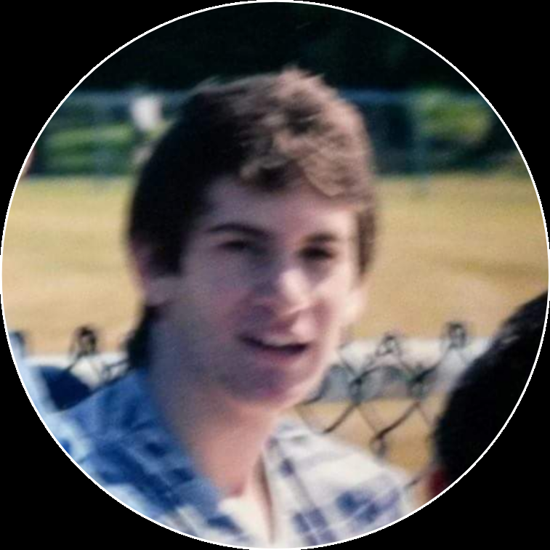
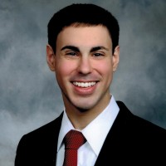
Yoni
Ben
Senior
CS-CogSci
Favorite Class: NLP
Favorite Project: Interactive Haunted House for RUPA
Internships: eightfold.ai, Center for Theoretical Neuroscience
Fun Fact: Plays drums in a band!
Senior
Math-Statistics
Favorite Class: Theory of Probability
Projects: Google Play, Wine Preferences, Orthopedic Sales, Graduate Admissions, Low-Income New Jersey Housing
Internships: Lee Spring, Fintegrity
Fun Fact: I love playing card games!

Slide 5
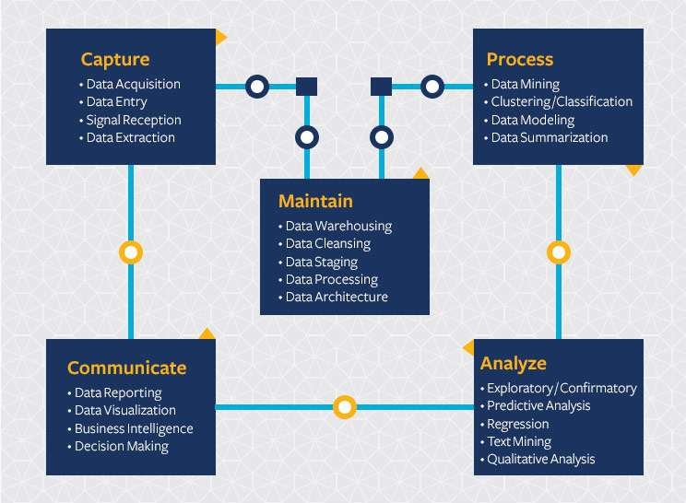
What is Data Science?
Glassdoor rates it as one of the best jobs on the market
Finding meaning in data
Asking the right questions
Telling a story through visualizations
Mix of statistics, computer science, business insight, and more
Source: https://datascience.berkeley.edu/about/what-is-data-science/

Slide 6
What do we have to offer?

Slide 7
Bootcamping
What will you be learning?
Basic Programming Refresher
Working with Data
Classic statistical algorithms
Machine Learning
Visualization and Presentation
The basic skills and curiosity to continue improving on your own!

Slide 8
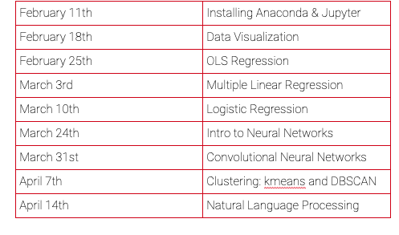
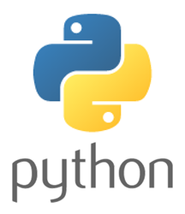









What you’ll be learning
What you’ll get to put on your resume
Python
Anaconda
Jupyter
Streamlit
Pandas
NumPy
Statsmodels
Scikit-Learn
Matplotlib
Pytorch

Slide 9
Software
Everything is free and open source, but now we’ll download the tools we’ll need to do data science:
Anaconda
https://www.anaconda.com/distribution/
Jupyter Notebooks
A text editor
Visual Studio Code
Atom, Sublime, etc…
pip install streamlit
Cutting edge data visualization tool we’ll be working with

Slide 10
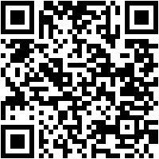
Interested in helping us turn this bootcamp into a community?
Join our Groupme!

Slide 11
Email: rutgersdsbootcamp@gmail.com
info@rucogsciclub.com
statisticsrutgers@gmail.com
Github:
www.github.com/rucogsciclub/Data_Science_Bootcamp

Slide 12
Crash Course in Python
Why Python?
We’re here for data science, so let’s check out what Stackoverflow Trends has to say:
Easy to read / learn
Open Source → people are always building cool tools and sharing them for free
Relevant beyond just data science
Outside resources you can use to learn:
https://www.python.org/about/gettingstarted/
https://www.learnpython.org/
https://www.codecademy.com/learn/learn-python
https://www.kaggle.com/learn/python
Let’s write some code, and learn how Jupyter notebooks work

Slide 13
What people are saying about Data Science Bootcamp
With this app, I’m confident to plan a trip to rural Vietnam
Wendy Moss, CA
Feels like magic
Ronny Rider, NYC
Did not help me cure my bad foot fungus, but the teachers are cute
Abby Manning, NYC

